Slide 1
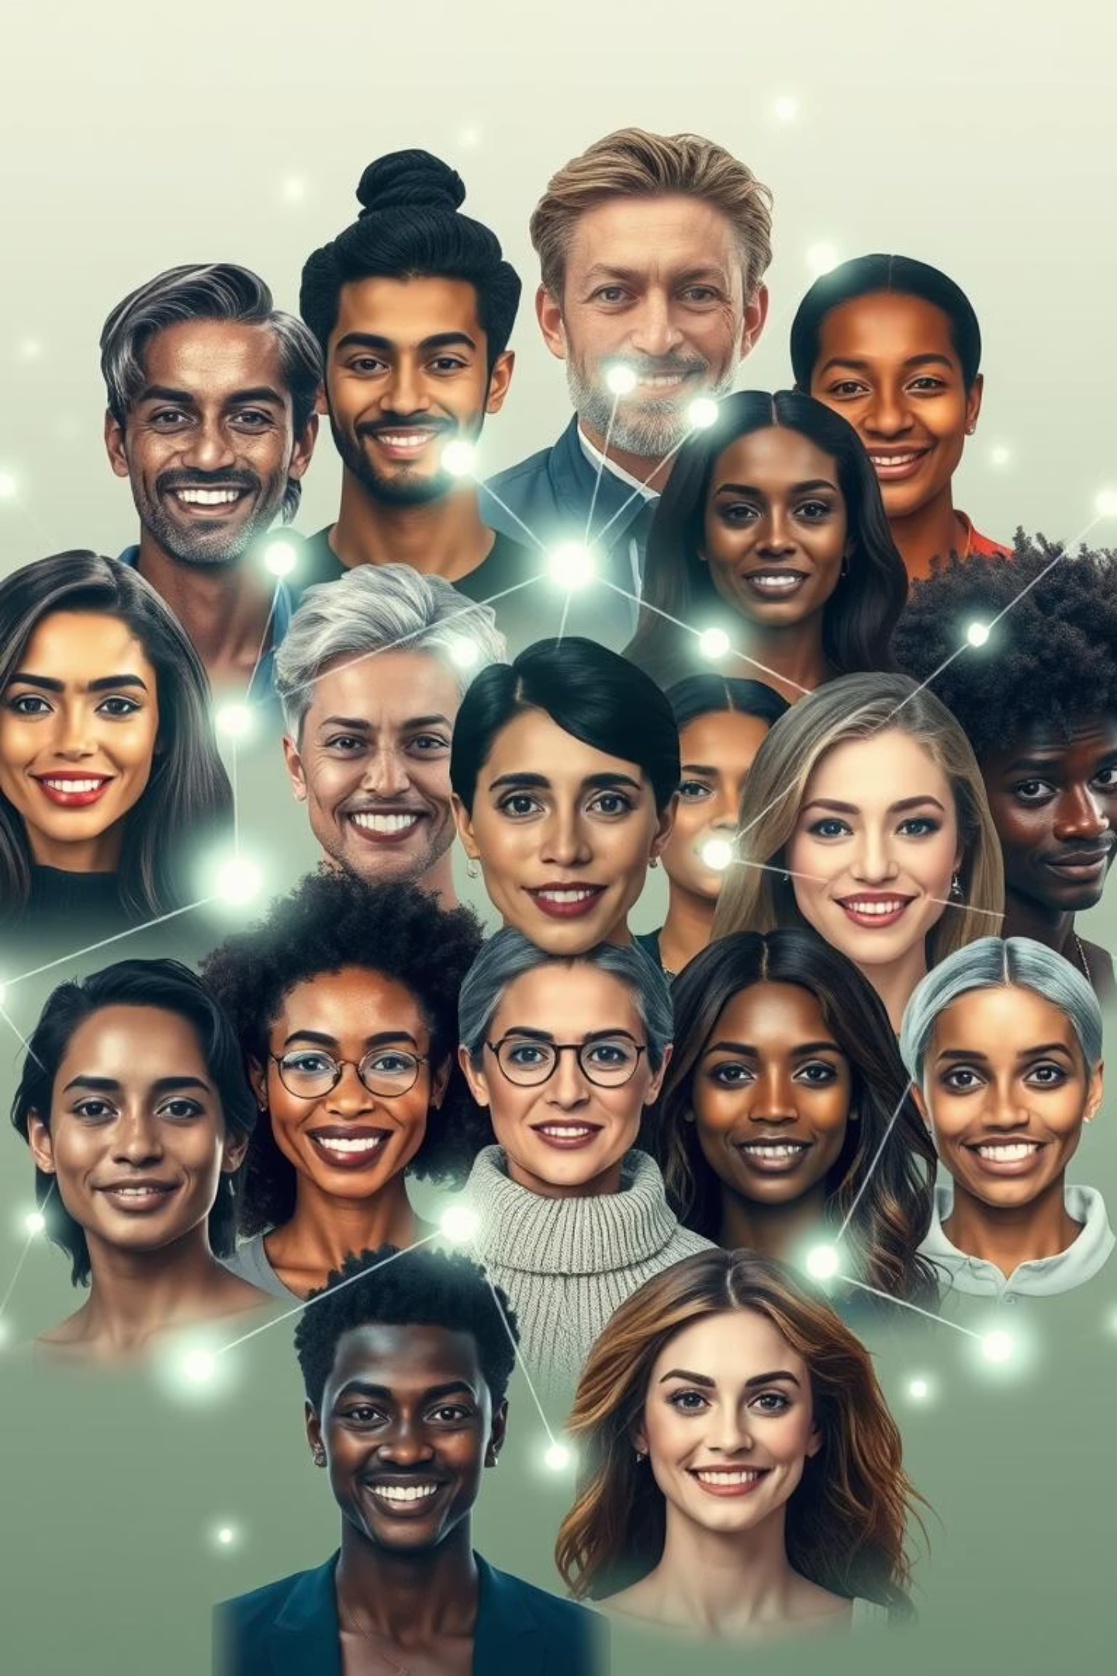

INTERNSHIP PHASE II:
Deep Learning and Reinforcement Learning
Exploring Bias in Models
Sanjusri.S.R-1BG23CS133
Shambhavi Pandey-1BG23CS137
Vinutha.B.S-1BG23CS188

Slide 2

Project Objective
Develop a CNN-based classifier to predict the Eyeglasses attribute from facial images using the CelebA dataset.Analyze and compare model performance across demographic subgroups: gender (male/female) and skin tone (light/dark).Detect and evaluate potential algorithmic bias and identify fairness issues in deep learning models.

Slide 3

Methodology: A Step-by-Step Approach
Data Preparation
Mount Google Drive, extract CelebA, load and preprocess labels, and visualize sample images for verification.
Dataset Structuring
Link images to "Eyeglasses" labels and split into 80:20 train/validation sets using ImageDataGenerators.
Model Development
Build a simple CNN with two convolutional layers, max-pooling, a dense layer, and sigmoid output.
Training & Evaluation
Train the model over 5 epochs and evaluate performance by plotting accuracy and loss.
Bias Analysis
Analyze performance across demographic subgroups to identify bias based on gender or skin tone.

Slide 4
Key Assumptions: Framing Our Analysis
Binary Gender
Gender is binary (Male=1, Female=0) in the CelebA dataset.
Brightness as Skin Tone
Skin tone is approximated using image brightness as a proxy.
Representative Dataset
The dataset is assumed to be representative, attributing biases to model behavior.
Suitable Architecture
The chosen model architecture is suitable for binary classification tasks.
Sufficient Sampling
Sampling ~1000 images is considered sufficient to detect bias trends.

Slide 5
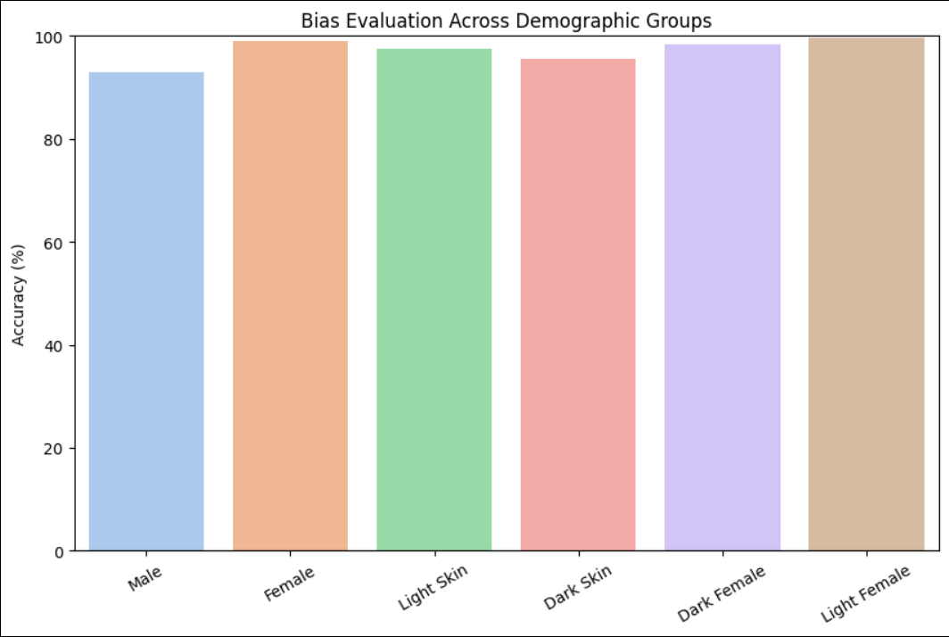
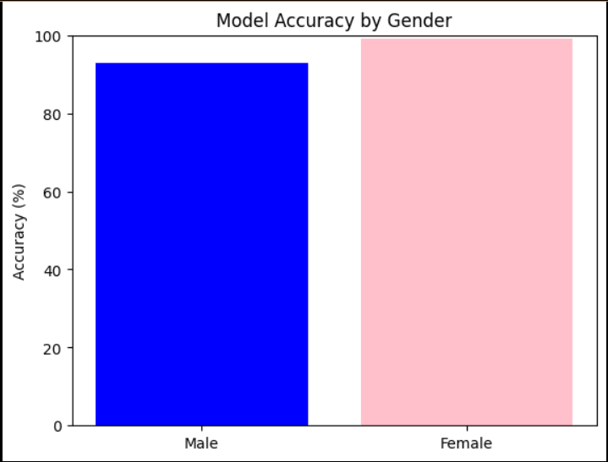
Model Evaluation: Performance Metrics
The model showed good overall performance. However, gender and intersectional biases were observed. Females, especially light-skinned, had higher accuracy.
Skin tone accuracy was balanced, yet intersectional analysis revealed variations.

Slide 6
Deeper Dive: Bias in Detail
The eyeglasses model exhibited a notable gender bias, with higher accuracy for female faces (99.13%) compared to male faces (92.99%). This disparity suggests potential imbalances in training data or learned feature differences.
While skin tone accuracy was relatively balanced, the highest performance was observed in light-skinned females (99.68%). This highlights the critical need for intersectional fairness and diversified training data to reduce bias.
The eyeglasses classification model showed higher accuracy for female faces than male faces, indicating a gender bias in predictions. This suggests the model performs better on detecting eyeglasses in females, possibly due to imbalance in the training data or learned feature differences.
In contrast, accuracy across light and dark skin tones was fairly balanced, showing minimal skin tone bias. However, the best performance was observed in light-skinned females, highlighting the need for intersectional fairness and potential improvements in data diversity and model training.

Slide 7
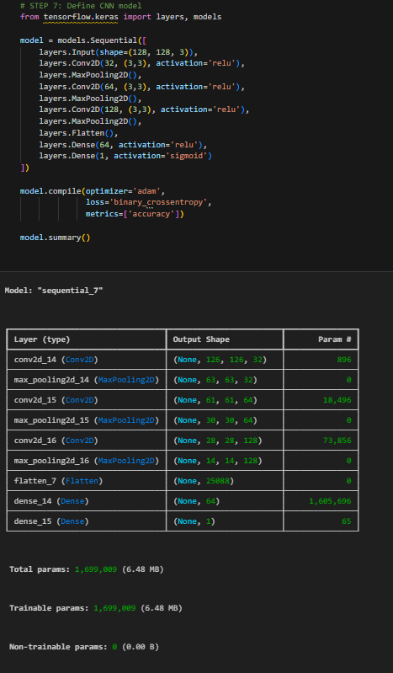




Project Summary:
Model Training
Successfully trained a CNN to classify eyeglasses in facial images.
Bias Detection
Identified measurable accuracy gaps across gender and skin tone groups.
Fairness Analysis
Quantified potential fairness concerns through detailed visualization.
AI Implications
Highlighted the importance of fairness-aware evaluation in AI systems.

Slide 8
Future Enhancements:
Dataset Expansion
Bias Mitigation
Model Architecture
Utilize larger, more balanced datasets for improved generalization.
Implement techniques like re-weighting or data augmentation.
Experiment with robust models like ResNet or EfficientNet for better performance.
Skin Tone Accuracy
Intersectional Depth
Employ sophisticated methods for skin tone analysis, leveraging labeled datasets.
Conduct deeper analysis of multi-attribute bias combinations for comprehensive fairness.

Slide 9
Reflections and Key Learnings
What We Learned:
Skills Gained:
Evaluating AI models beyond overall accuracy is crucial.
TensorFlow model building and implementation.
Comprehensive dataset handling and preprocessing techniques.
Real-world AI systems can carry unintentional demographic biases.
Advanced bias and fairness evaluation methods.
Data preparation and sampling critically affect fairness outcomes.
Visualization of demographic performance differences.

